Slide 1
Ad-hoc On-demand Distance Vector Routing Protocol: CBR Traffic Implementation
Name: Lavkush Singh and Manik Garg
Enroll. No: U101115FCS113, U101115FCS199
Section: S6
Semester – V
Program – B.Tech Batch 2015-19

Slide 2
What is AODV?
Reactive Routing Protocol
No extra traffic: Nodes are independent
Route is created on the node’s demand
Remains active as long as data transmission is happening
Avoids Counting to infinity problem
Three types of control maintenance messages:
RREQ
RREP
RERR

Slide 3
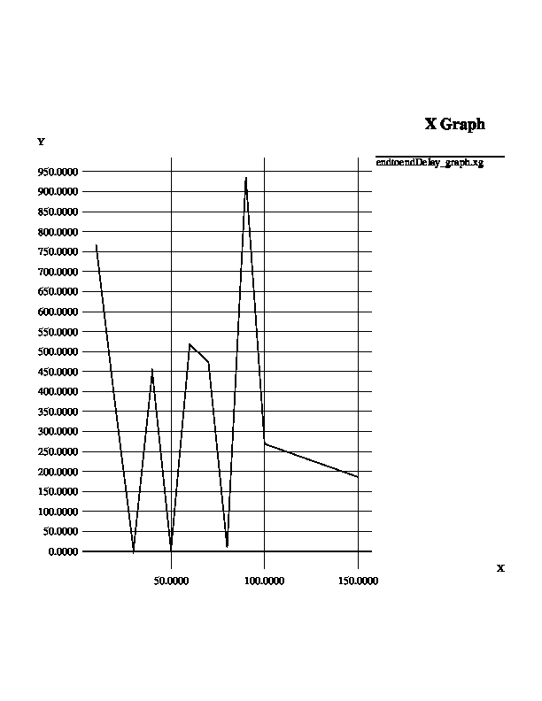
End to End Delay

Slide 4
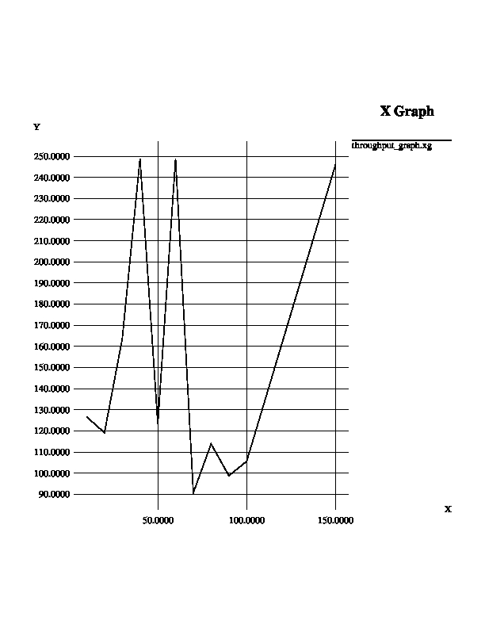
Throughput

Slide 5
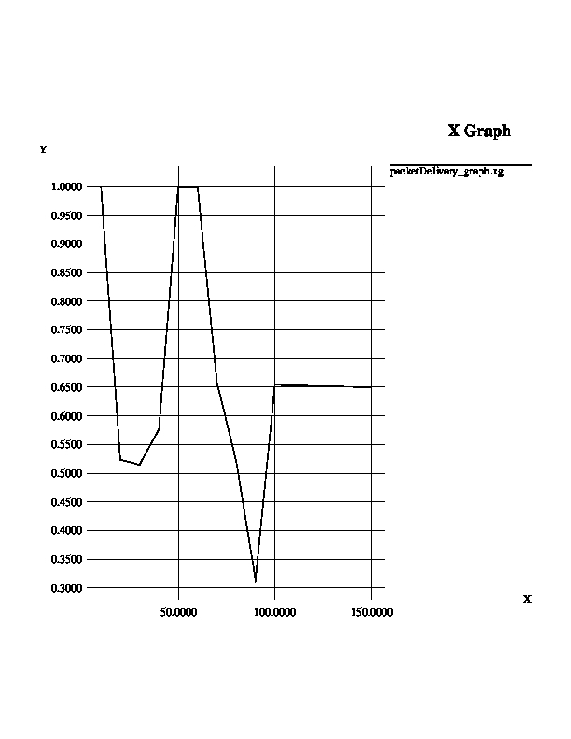
PDR

Slide 6
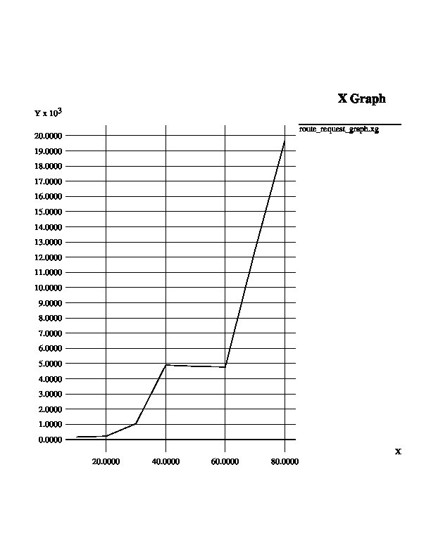
Route Request

Slide 7
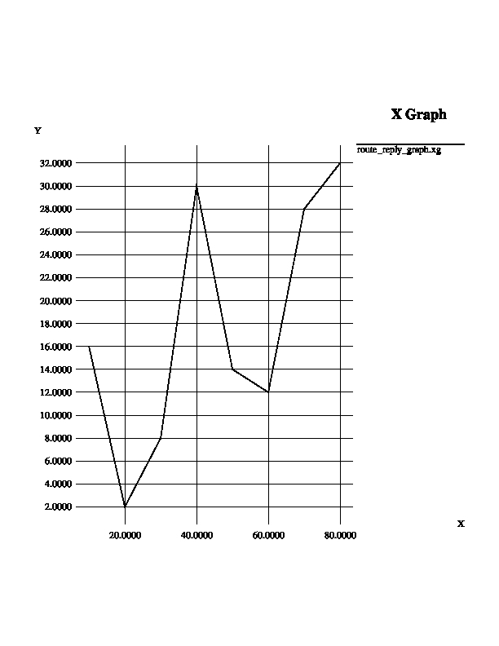
Route Reply

